Slide 1


Retrieval of contact details
from social media accounts of terrorists.
WeRockers INTL-DA-16
Students:
Sai Ranjani Chandrashekar (Team Leader)
Malvika Parulekar
Anushka Agarwala
Karan Prajapat
Shivani Thakur
Mentors:
Dr. Subodh Deolekar
Dr. Sonal Daulatkar
College name: S.P. Mandali's Prin. L. N. Welingkar Institute of Management Development and Research, Mumbai (WeSchool)

Slide 2

INTL-DA-16 Problem Statement
Terrorists often create social media accounts for terror recruitment. In a lot of cases, they use real phone numbers and/or email addresses for registering these accounts so as to be able to directly communicate with potential recruits. Build a solution that is able to extract the phone number and/ or email address used to set up such social media accounts. Profile URL(s) shall be supplied as an input parameter.

Slide 3








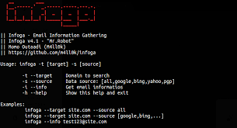
Tech Stack
Streamlit.io
Python libraries |  |  | Pandas
tweepy | sherlock | folium | geocoder
textBlob | matplotlib | os | beautiful soup 4 (bs4)
requests | regular expressions (re) | requests_tor | infoga

Slide 4
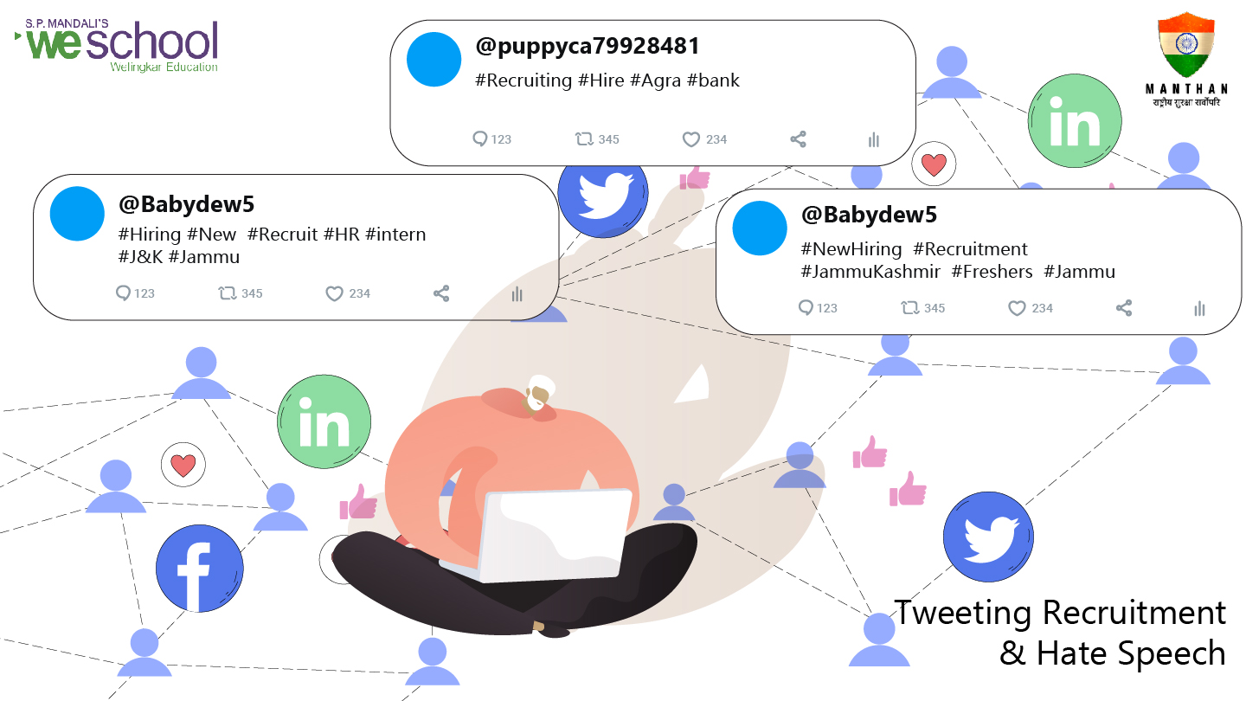

Slide 5

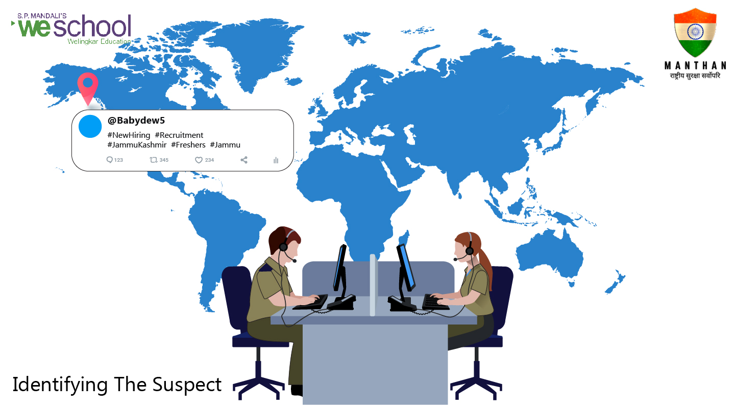

Slide 6
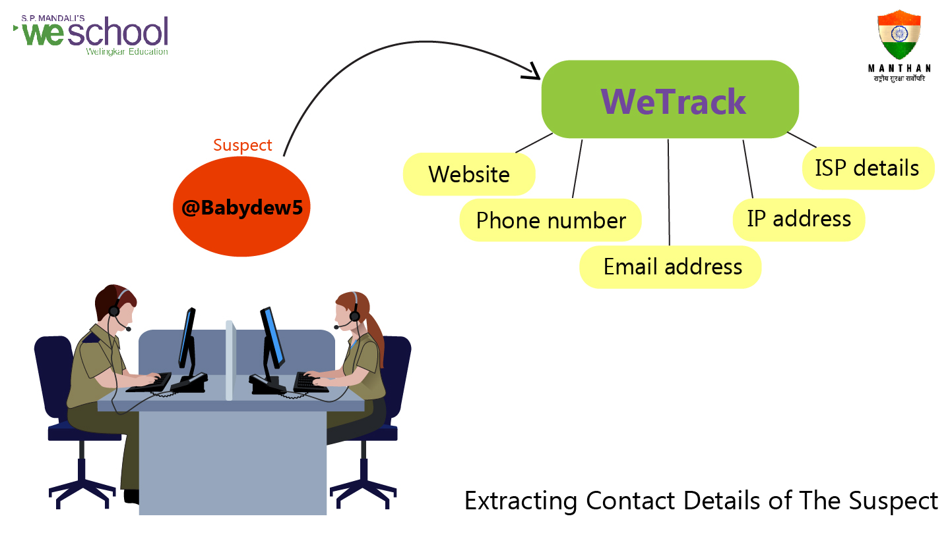

Slide 7
Tech Stack
Streamlit.io
Python libraries |  |  | Pandas
tweepy | sherlock | folium | geocoder
textBlob | matplotlib | os | beautiful soup 4 (bs4)
requests | regular expressions (re) | requests_tor | infoga

Slide 8
Features of the Solution
User Friendly
Real time
Scalable
Reliable
360 degree view of suspect terror suspect

Slide 9
Deliverables of the Solution
Email Address
Contact Number
Location (Long., Lat.)
IP Address
ISP details

Slide 10

Tech Stack
Streamlit.io
PYTHON Libraries |  |  | pandas
beautiful soup (bs4) | tweepy | sherlock | geocoder
os | infoga | textblob | Requests_tor
re | Folium | matplotlib | scrapy

Slide 11
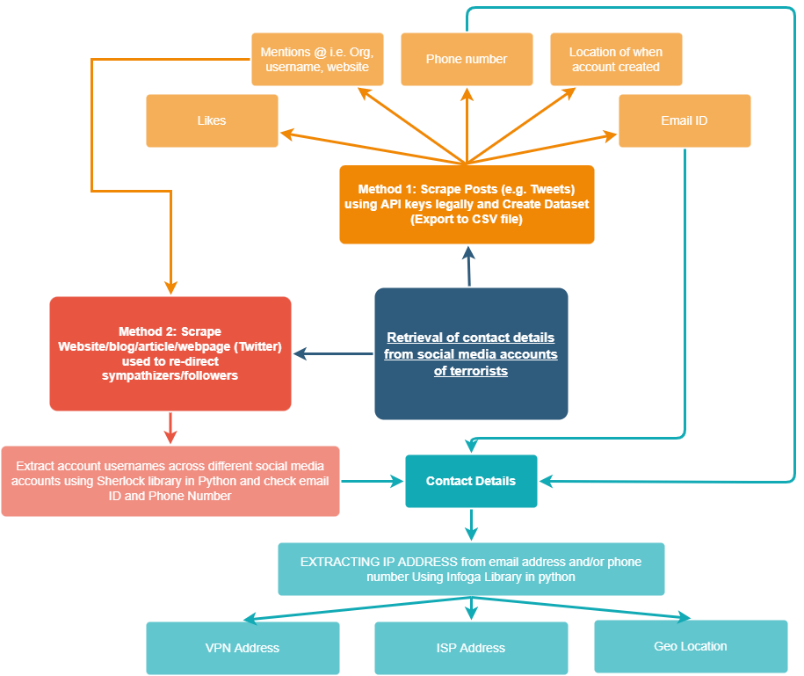
MIND MAP

Slide 12

Method 1
Data available in Posts/Tweets
Scrape the data
Access using API [Legally Available]
Export Contact details to .csv
Email id
Contact #
Mentions- i.e username, Website, Org
Likes
Location- where account created

Slide 13
Method 2
Data available on websites/blogs/ articles (present in bio)
Scrape the content of these links
Identify emails, contacts, some other organization/entity information
Identify emails, contacts, some other organization/entity information
Extract account usernames across different social media a/cs using
sherlock library in python and check email id and phone #
Contact details
Extract IP address from email id and phone # using Infoga library
Geo Location
VPN
ISP address

Slide 14
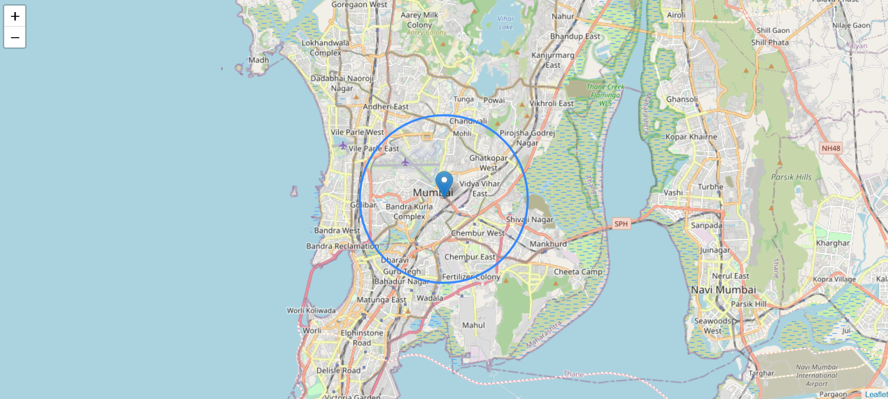
Location on Map using Geocoder in Python

Slide 15
Thank you

